Slide 1
Abstract class in Java
Instructor :Prashant Mishra
BIAS Bhimtal

Slide 2
Abstraction in Java
A class which is declared with the abstract keyword is known as an abstract class in Java. It can have abstract and non-abstract methods (method with the body).
Abstraction is a process of hiding the implementation details and showing only functionality to the user.
Another way, it shows only essential things to the user and hides the internal details, for example, sending SMS where you type the text and send the message. You don't know the internal processing about the message delivery.
Abstraction lets you focus on what the object does instead of how it does it.

Slide 3
Abstract class in Java
A class which is declared as abstract is known as an abstract class. It can have abstract and non-abstract methods. It needs to be extended and its method implemented. It cannot be instantiated.
An abstract class must be declared with an abstract keyword.
It can have abstract and non-abstract methods.
It cannot be instantiated.
It can have constructors and static methods also.
It can have final methods which will force the subclass not to change the body of the method.

Slide 4
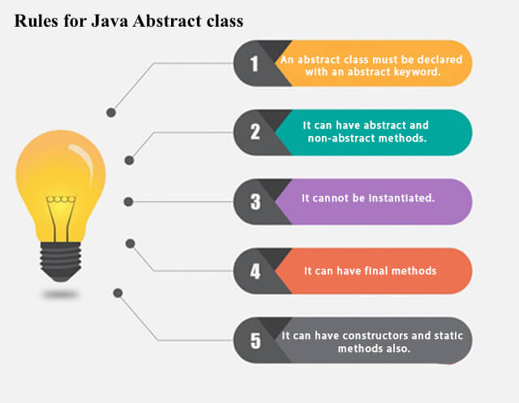
Example of abstract class
abstract class A{}

Slide 5
Abstract Method in Java
A method which is declared as abstract and does not have implementation is known as an abstract method.
Example of abstract method
abstract void printStatus();//no method body and abstract

Slide 6
Abstract class that has an abstract method
abstract class Bike{
abstract void run();
}
class Honda4 extends Bike{
void run(){System.out.println("running safely");}
public static void main(String args[]){
Bike obj = new Honda4();
obj.run();
}
}

Slide 7
real scenario of Abstract class
In this example, Shape is the abstract class, and its implementation is provided by the Rectangle and Circle classes.

Slide 8
TestAbstraction1.java
abstract class Shape{
abstract void draw();
}
//In real scenario, implementation is provided by others i.e. unknown by end user
class Rectangle extends Shape{
void draw() {System.out.println("drawing rectangle");}
}
class Circle1 extends Shape{
void draw(){System.out.println("drawing circle");}
}
//In real scenario, method is called by programmer or user
class TestAbstraction1{
public static void main(String args[]){
Shape s=new Circle1();//In a real scenario, object is provided through method, e.g., getShape() method
s.draw();
}
}

Slide 9
TestBank.java
abstract class Bank{
abstract int getRateOfInterest();
}
class SBI extends Bank{
int getRateOfInterest(){return 7;}
}
class PNB extends Bank{
int getRateOfInterest(){return 8;}
}
class TestBank{
public static void main(String args[]){
Bank b;
b=new SBI();
System.out.println("Rate of Interest is: "+b.getRateOfInterest()+" %");
b=new PNB();
System.out.println("Rate of Interest is: "+b.getRateOfInterest()+" %");
}}
Rate of Interest is: 7 %
Rate of Interest is: 8 %

Slide 10
Abstract class having constructor, data member and methods
An abstract class can have a data member, abstract method, method body (non-abstract method), constructor, and even main() method.
Rule: If there is an abstract method in a class, that class must be abstract.
Rule: If you are extending an abstract class that has an abstract method, you must either provide the implementation of the method or make this class abstract.
TestAbstraction2.java

Slide 11
//Example of an abstract class that has abstract and non-abstract methods
abstract class Bike{
Bike(){System.out.println("bike is created");}
abstract void run();
void changeGear(){System.out.println("gear changed");}
}
//Creating a Child class which inherits Abstract class
class Honda extends Bike{
void run(){System.out.println("running safely..");}
}
//Creating a Test class which calls abstract and non-abstract methods
class TestAbstraction2{
public static void main(String args[]){
Bike obj = new Honda();
obj.run();
obj.changeGear();
}
}
bike is created
running safely..
gear changed

Slide 12
Interface in Java
An interface in java is a blueprint of a class. It has static constants and abstract methods.
The interface in Java is a mechanism to achieve abstraction. There can be only abstract methods in the Java interface, not method body. It is used to achieve abstraction and multiple inheritance in Java.
In other words, you can say that interfaces can have abstract methods and variables. It cannot have a method body
ava Interface also represents the IS-A relationship.
It cannot be instantiated just like the abstract class.
Since Java 8, we can have default and static methods in an interface.
Since Java 9, we can have private methods in an interface.

Slide 13
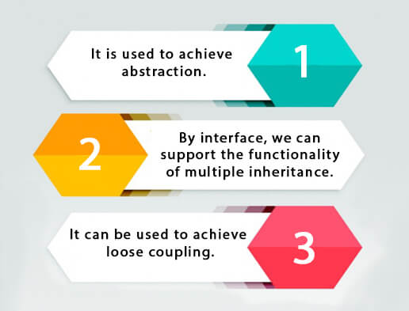
Why use Java interface?

Slide 14
How to declare an interface?
An interface is declared by using the interface keyword. It provides total abstraction; means all the methods in an interface are declared with the empty body, and all the fields are public, static and final by default. A class that implements an interface must implement all the methods declared in the interface.
Syntax:
interface <interface_name>{
// declare constant fields
// declare methods that abstract
// by default.
}

Slide 15
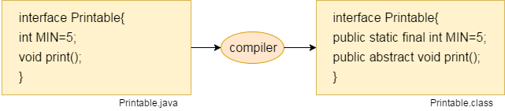
The Java compiler adds public and abstract keywords before the interface method. Moreover, it adds public, static and final keywords before data members.
In other words, Interface fields are public, static and final by default, and the methods are public and abstract.

Slide 16
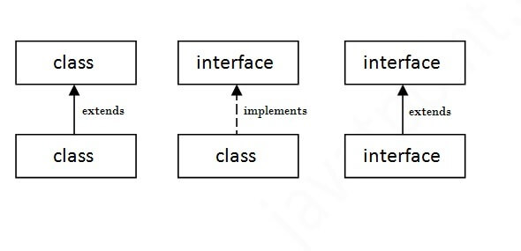
The relationship between classes and interfaces
As shown in the figure given below, a class extends another class, an interface extends another interface, but a class implements an interface.

Slide 17
Java Interface Example
In this example, the Printable interface has only one method, and its implementation is provided in the A6 class.
interface printable{
void print();
}
class A6 implements printable{
public void print(){System.out.println("Hello");}
public static void main(String args[]){
A6 obj = new A6();
obj.print();
}
}
Output:
Hello

Slide 18
Java Interface Example: Drawable
In this example, the Drawable interface has only one method. Its implementation is provided by Rectangle and Circle classes. In a real scenario, an interface is defined by someone else, but its implementation is provided by different implementation providers. Moreover, it is used by someone else. The implementation part is hidden by the user who uses the interface.
TestInterface1.java
//Interface declaration: by first user
interface Drawable{
void draw();
}
//Implementation: by second user
class Rectangle implements Drawable{
public void draw(){System.out.println("drawing rectangle");}
}
class Circle implements Drawable{
public void draw(){System.out.println("drawing circle");}
}
//Using interface: by third user
class TestInterface1{
public static void main(String args[]){
Drawable d=new Circle();//In real scenario, object is provided by method e.g. getDrawable()
d.draw();
}}

Slide 19
Java Interface Example: Bank
TestInterface2.java
interface Bank{
float rateOfInterest();
}
class SBI implements Bank{
public float rateOfInterest(){return 9.15f;}
}
class PNB implements Bank{
public float rateOfInterest(){return 9.7f;}
}
class TestInterface2{
public static void main(String[] args){
Bank b=new SBI();
System.out.println("ROI: "+b.rateOfInterest());
}}
Output:
ROI: 9.15

Slide 20
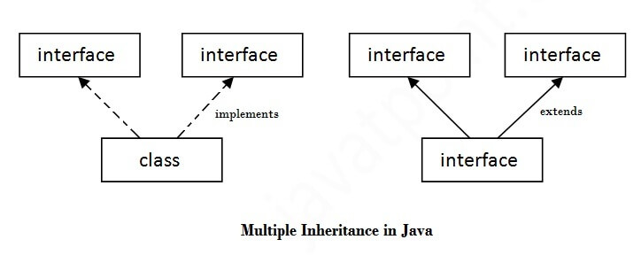
Multiple inheritance in Java by interface
If a class implements multiple interfaces, or an interface extends multiple interfaces, it is known as multiple inheritance.

Slide 21
interface Printable{
void print();
}
interface Showable{
void print();
}
class TestInterface3 implements Printable, Showable{
public void print(){System.out.println("Hello");}
public static void main(String args[]){
TestInterface3 obj = new TestInterface3();
obj.print();
}
}
Output:
Hello

Slide 22
Interface inheritance
A class implements an interface, but one interface extends another interface.
interface Printable{
void print();
}
interface Showable extends Printable{
void show();
}
class TestInterface4 implements Showable{
public void print(){System.out.println("Hello");}
public void show(){System.out.println("Welcome");}
public static void main(String args[]){
TestInterface4 obj = new TestInterface4();
obj.print();
obj.show();
}
}
Output:
HelloWelcome

Slide 23
Default Method in Interface
TestInterfaceDefault.java
interface Drawable{
void draw();
default void msg(){System.out.println("default method");}
}
class Rectangle implements Drawable{
public void draw(){System.out.println("drawing rectangle");}
}
class TestInterfaceDefault{
public static void main(String args[]){
Drawable d=new Rectangle();
d.draw();
d.msg();
}}
Output:
drawing rectangle
default method

Slide 24
Static Method in Interface
Since Java 8, we can have static method in interface. Let's see an example:
File: TestInterfaceStatic.java
interface Drawable{
void draw();
static int cube(int x){return x*x*x;}
}
class Rectangle implements Drawable{
public void draw(){System.out.println("drawing rectangle");}
}
class TestInterfaceStatic{
public static void main(String args[]){
Drawable d=new Rectangle();
d.draw();
System.out.println(Drawable.cube(3));
}}
Output:
drawing rectangle
27

Slide 25
Nested Interface in Java
Note: An interface can have another interface which is known as a nested interface. We will learn it in detail in the nested classes chapter. For example:
interface printable{
void print();
interface MessagePrintable{
void msg();
}
}

Slide 26
Java Nested Interface
An interface i.e. declared within another interface or class is known as nested interface. The nested interfaces are used to group related interfaces so that they can be easy to maintain. The nested interface must be referred by the outer interface or class. It can't be accessed directly.
Points to remember for nested interfaces
There are given some points that should be remembered by the java programmer.
Nested interface must be public if it is declared inside the interface but it can have any access modifier if declared within the class.
Nested interfaces are declared static implicitely.

Slide 27
Syntax of nested interface which is declared within the interface
interface interface_name{
...
interface nested_interface_name{
...
}
}
Syntax of nested interface which is declared within the class
class class_name{
...
interface nested_interface_name{
...
}
}

Slide 28
Example of nested interface
interface Showable{
void show();
interface Message{
void msg();
}
}
class TestNestedInterface1 implements Showable.Message{
public void msg(){System.out.println("Hello nested interface");}
public static void main(String args[]){
Showable.Message message=new TestNestedInterface1();//upcasting here
message.msg();
}
}
Output:hello nested interface

Slide 29
Example of nested interface which is declared within the class
class A{
interface Message{
void msg();
}
}
class TestNestedInterface2 implements A.Message{
public void msg(){System.out.println("Hello nested interface");}
public static void main(String args[]){
A.Message message=new TestNestedInterface2();//upcasting here
message.msg();
}
}

Slide 30
Can we define a class inside the interface?
Yes, If we define a class inside the interface, java compiler creates a static nested class. Let's see how can we define a class within the interface:
interface M{
class A{}
}

Slide 31
Difference between abstract class and interface
Abstract class | Interface
1) Abstract class can have abstract and non-abstractmethods. | Interface can have only abstract methods. Since Java 8, it can have default and static methods also.
2) Abstract class doesn't support multiple inheritance. | Interface supports multiple inheritance.
3) Abstract class can have final, non-final, static and non-static variables. | Interface has only static and final variables.
4) Abstract class can provide the implementation of interface. | Interface can't provide the implementation of abstract class.
5) The abstract keyword is used to declare abstract class. | The interface keyword is used to declare interface.

Slide 32
6) An abstract class can extend another Java class and implement multiple Java interfaces. | An interface can extend another Java interface only.
7) An abstract class can be extended using keyword "extends". | An interface can be implemented using keyword "implements".
8) A Java abstract class can have class members like private, protected, etc. | Members of a Java interface are public by default.
9)Example: public abstract class Shape{ public abstract void draw(); } | Example: public interface Drawable{ void draw(); }

Slide 33
Example of abstract class and interface in Java
//Creating interface that has 4 methods
interface A{
void a();//bydefault, public and abstract
void b();
void c();
void d();
}
//Creating abstract class that provides
the implementation of one method of A interface
abstract class B implements A{
public void c(){System.out.println("I am C");}
}
//Creating subclass of abstract class, now we need to provide the implementation of rest of the methods
class M extends B{
public void a(){System.out.println("I am a");}
public void b(){System.out.println("I am b");}
public void d(){System.out.println("I am d");}
}
//Creating a test class that calls the methods of A interface
class Test5{
public static void main(String args[]){
A a=new M();
a.a();
a.b();
a.c();
a.d();
}}
Output:
I am a
I am b
I am c
I am d

